Slide 1
2021-22 School Site Council
Notes:
Attendance:
Teachers: Glassford, Dunham
School Leaders: Karpowicz, Flores, L.Yxcot-Nario
Parents:
Students: Dylan N.

Slide 2
Agenda
Welcome & Check-in
What is SSC & Assigning Roles
Approve ESSER Plan
Boys & Girls Club Grant
Set Meeting #2 - Date, Time
Upcoming Dates
Public Comment
Notes:
Roll Call:
Meeting Time starts:

Slide 3
Introductions (name & role/student)
What are you looking forward to at Alpha this year?

Slide 4
School Site Updates
Total Students: 504
9th grade - 135
10th grade - 132
11th grade - 122
12th grade - 114
~90% attendance (goal is 94%)
Added new classes this year:
AP Chemistry
AP Environmental Science
Student Government voting took place today!
Following all COVID safety protocols, no outbreaks on campus!
Have hosted 2 vaccination clinics and one more next week!
Contracted with outside group to do on-site PCR testing every Monday

Slide 5
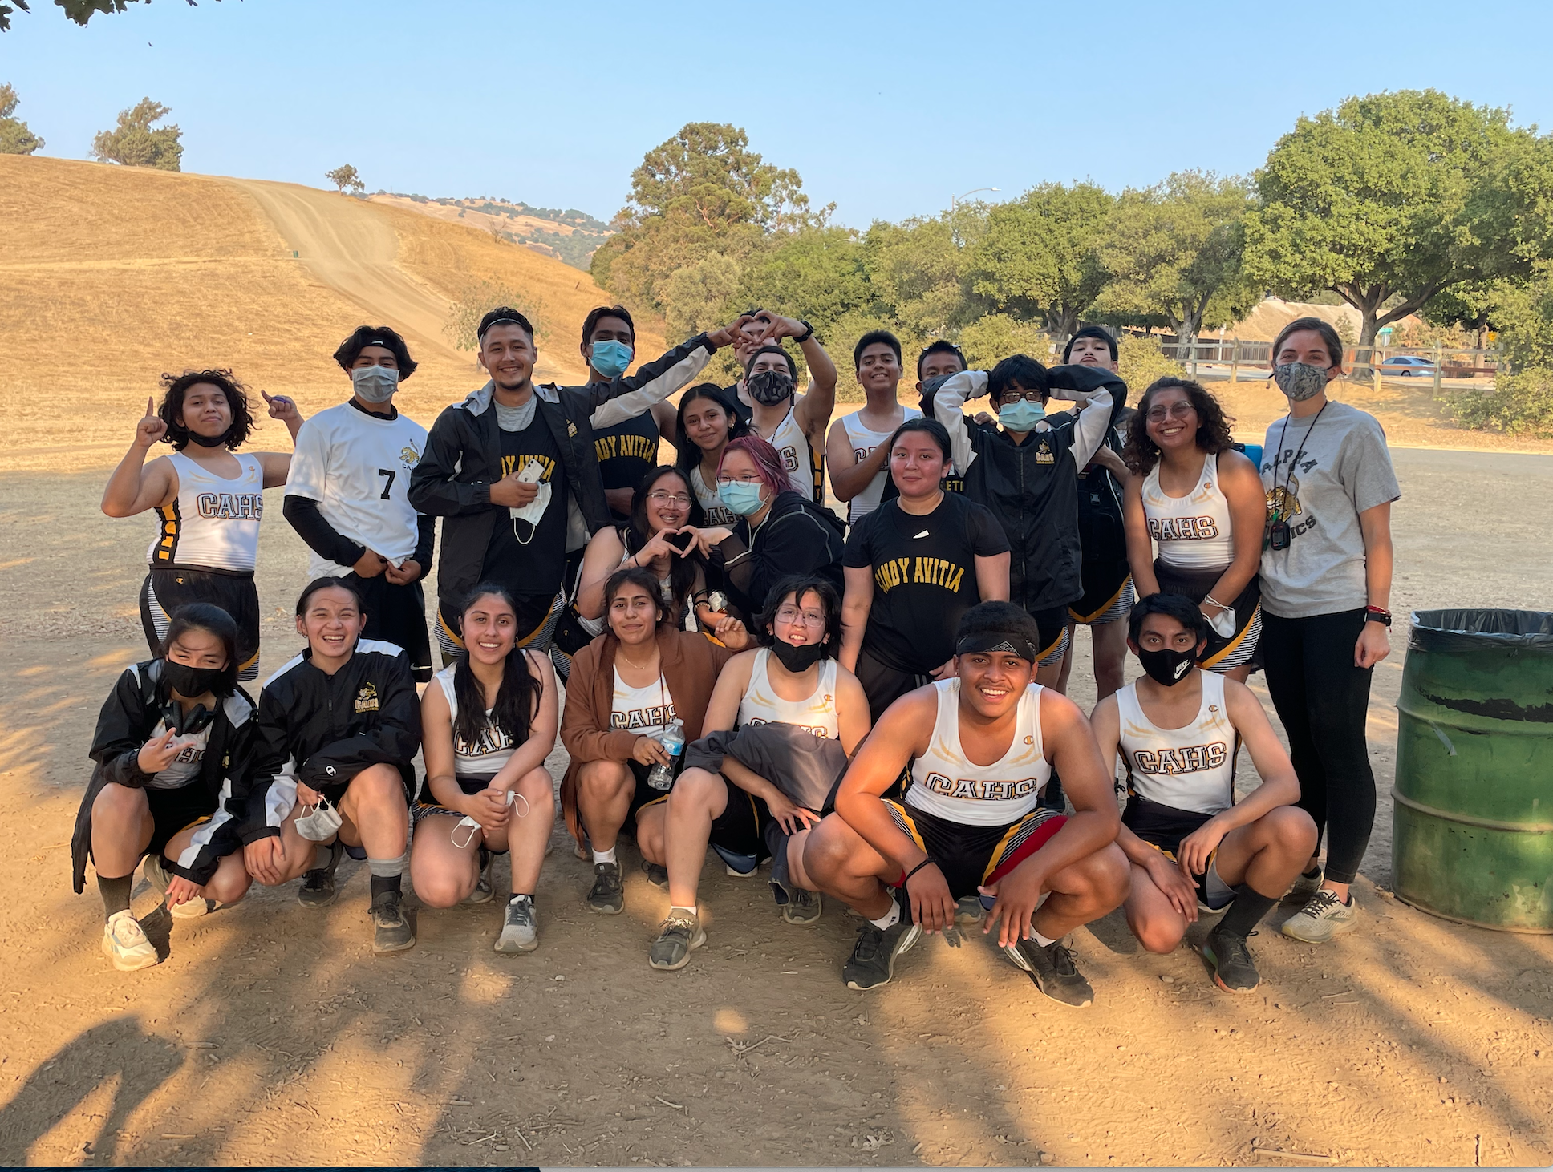

Slide 6
School Site Council Key Topics
The School Site Council (SSC) is an opportunity for parents, students, and school staff to be involved with decision making at the school.
Main Responsibilities:
Help develop yearly goals and budget (Local Control Accountability Plan)
Monitor the implementation and effectiveness of the plan on an ongoing basis
Serve as an advisory team for the Principal
Any other goal/objective the SSC collectively decides to take on for the year.
Expectations
Attend SSC meetings every 4-6 weeks for approximately one hour.
Regularly attend school community events and maintain visibility with all school families
Collaborate and team with school leaders and staff to problem-solve school-site issues

Slide 7
School Site Council Membership
THERE IS AN EVEN NUMBER OF SSC MEMBERS (minimum of 10)
HALF OF SSC MEMBERSHIP is school staff (classroom teachers comprise the majority of school staff membership)
HALF OF SSC MEMBERSHIP is comprised of parents and/or community members or students (in secondary schools)
Typically:
2 SLT Members - Karpowicz & Yxcot-Nario
3 Teachers - Glassford, Dunham, De La Torre
3 Parents -
2 Students - Student Government President & VP

Slide 8
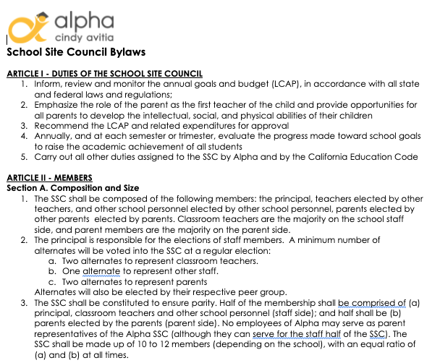
Adoption of By-Laws
Proposed Bylaws

Slide 9
School Site Council Membership
The president shall:
Along with the principal, facilitate the SSC meetings
Along with Principal, sign all letters, reports and other communications of the SSC
With Principal, prepare an agenda for each meeting and publicly post the agenda at the school site 72 hours in advance of each SSC meeting.
Perform other such duties as are prescribed by the SSC
The vice-president shall:
Represent the president in assigned duties
Substitute for the president in his or her absence
Be familiar with the committee’s bylaws, parliamentary procedures and Robert’s Rules of Order.

Slide 10
Elementary & Secondary School Emergency Funds ESSER
Purpose: to address students’ academic, social, emotional, and mental health needs, as well as any opportunity gaps that existed before, and were worsened by, the COVID-19 pandemic
CAHS plans to use funds to
supply school with PPE
support loss of learning due to the pandemic
support student mental health
Specifically we will:
Hire additional instructional roles to provide adequate coverage and instructional staffing - Academic Interventionist, Associate Teachers
Hire additional operational roles to provide support for operation of safe schools
Conduct COVID-19 Testing
Increase Custodial Costs

Slide 11
Boys and Girls Club ASSETs Grant
Mark Washbush

Slide 12
Meeting #2
When will we meet? What time?
Ms. K’s proposal:
November 9th
November 15th
November 16th
November 17th

Slide 13
Upcoming School Events
Charla con Ms. K 10/25
Family Conferences 10/25 - 10/29
Spirit Week 10/25 - 10/29
Vaccination Clinic 10/28 1-6pm
Expo Night 11/4
Notes:
Meeting Time End:

Slide 14
Public Comment

